Slide 1
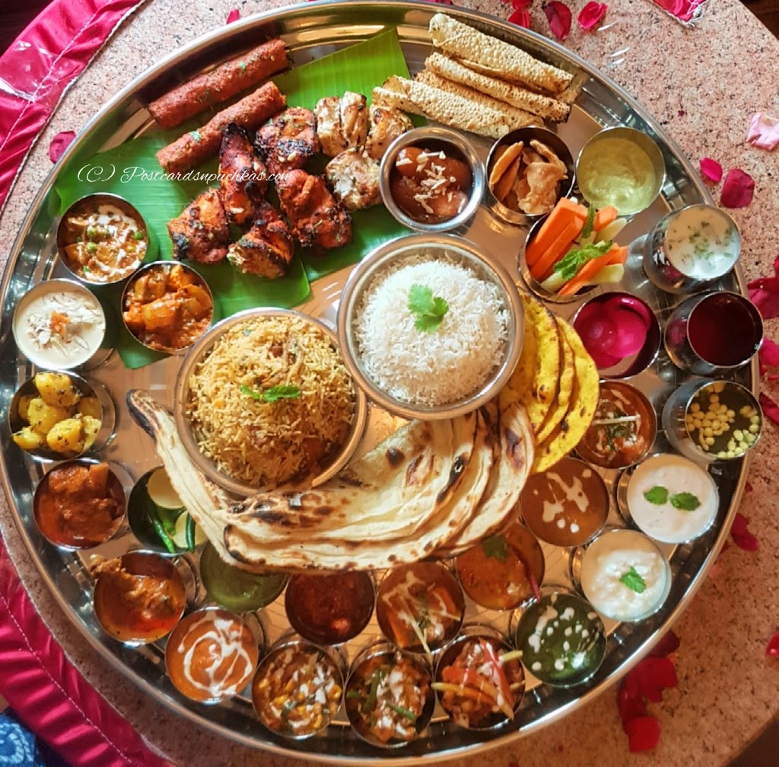
Recommend a Neighborhood to Open an Indian Restaurant @ San Jose, CA

Slide 2
Business Context and The Problem
San Jose is a large city surrounded by rolling hills and the largest city in Northern California
It is a multicultural and very diverse due to a large population of migrants from various parts of world
This has resulted in the establishment of various authentic ethnic restaurants in the city, ranging from Indian, Korean, Mexican, and Chinese, to Ethiopian
In this project we will try to find an optimal neighborhood to open a restaurant in San Jose
Specifically, this report will be targeted to stakeholders interested in opening an Indian restaurant in San Jose, CA
Since there are lots of restaurants in San Jose, we will try to find locations with less Indian cuisines
We are also particularly interested in neighborhoods known for restaurants but not with many Indian cuisines in vicinity

Slide 3
DATA
The following data sources will be used in this project to do the relevant analysis:
Neighborhoods in San Jose Wikipedia: https://en.wikipedia.org/wiki/Category:Neighborhoods_in_San_Jose,_California
Geocoder – Geocoder library and Nominatim API to determine the latitude and longitude for each of the neighborhoods
Location Data - Foursquare API will be leveraged to get the list of current restaurants and other most popular venues for each of those neighborhoods

Slide 4
Methodology
The following analysis will be used to find a best neighborhood:
Perform Data Wrangling to cleanup and reformat the data
Retrieve Retaurant and related categories from Venue category
See the distribution of Restaurants by Cuisine type
Identify neighborhoods with Indian restaurants
Find neighborhoods known for Restaurants
Pick a neighborhood that has the least ratio of Indian restaurants to overall restaurants

Slide 5
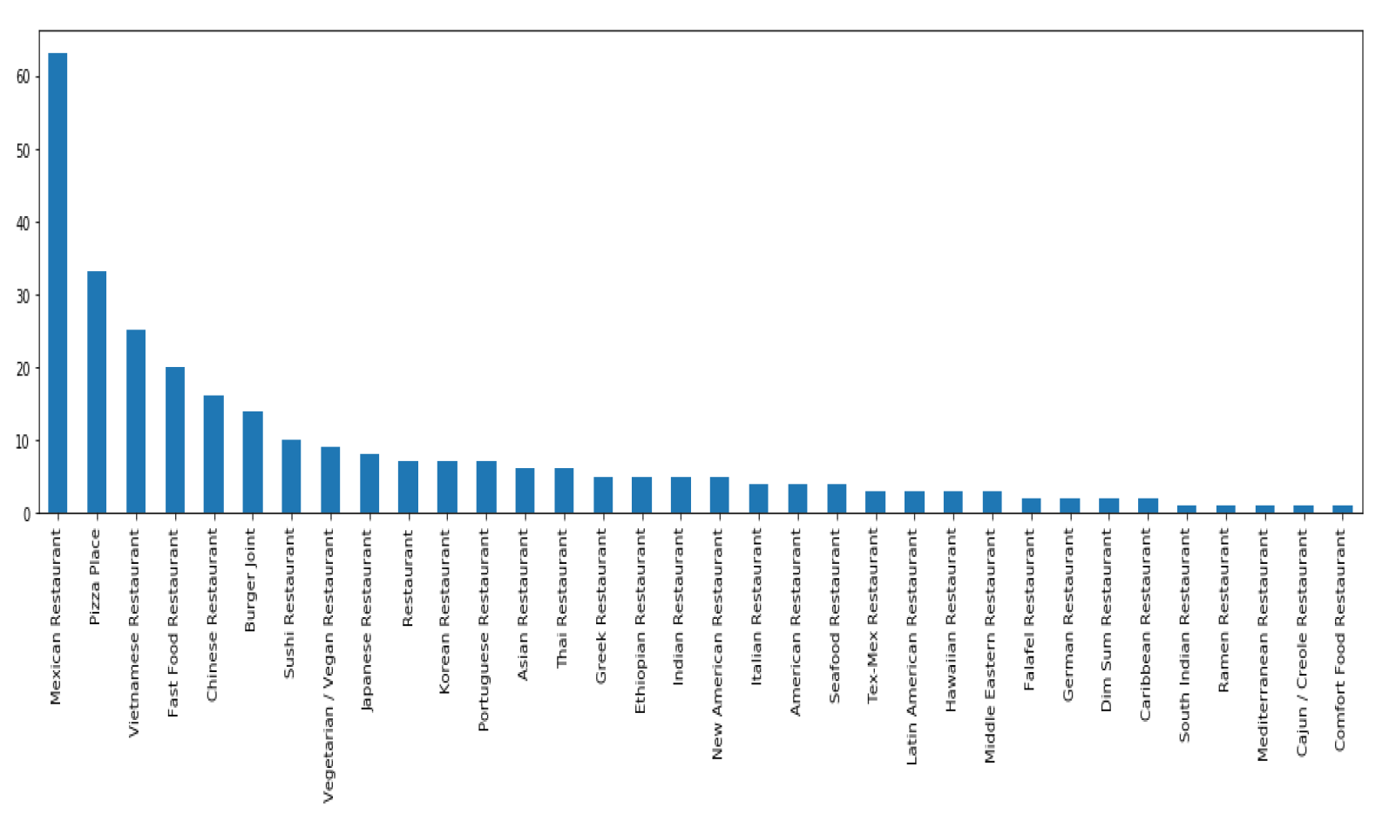
Distribution of Restaurants by Cuisine type:

Slide 6
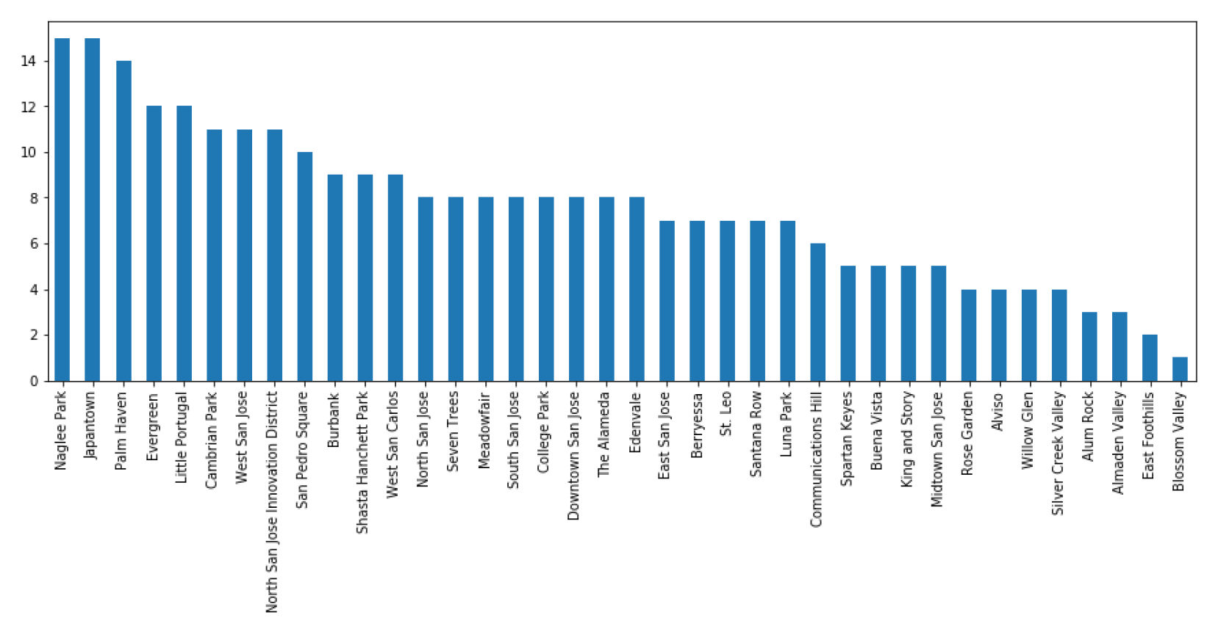
Neighborhoods that have more # of Restaurants:

Slide 7
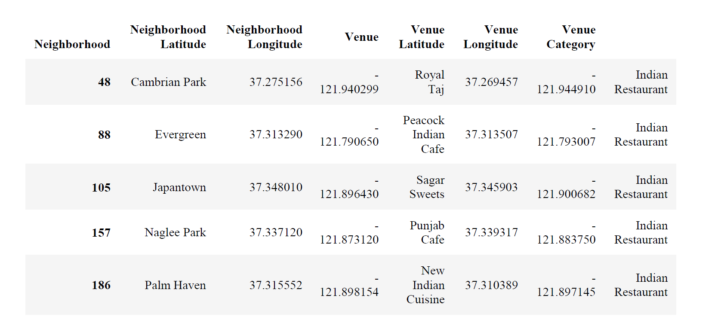
Neighborhoods with Indian restaurants:

Slide 8
Results and Discussion
Our analysis shows that there are great number of restaurants in San Jose
There are pockets of low restaurant density as well
Highest concentration of restaurants was detected on 3 neighborhoods: 1) Naglee Park 2) Japantown 3) Palm Haven
Surprisingly, there aren't many Indian restaurants in these neighborhoods
It is entirely possible that there is a very good reason for small number of Indian restaurants in any of those areas, reasons which would make them unsuitable for a new restaurant regardless of lack of competition in the area
Recommended zones should therefore be considered only as a starting point for more detailed analysis which could eventually result in location which has not only nearby competition but also other factors taken into account and all other relevant conditions met.

Slide 9
Conclusion
Purpose of this project was to identify San Jose neighborhoods with low ratio of Indian restaurants in order to aid stakeholders in narrowing down the search for optimal neighborhood for an Indian restaurant
By calculating #restaurants distribution from Foursquare data we have identified 3 neighborhoods that justify further analysis and can be used as starting points for final exploration by stakeholders
Final decision on optimal restaurant location will be made by stakeholders based on specific characteristics of neighborhoods and locations in every recommended zone, taking into consideration additional factors like attractiveness of each location (proximity to park or water), levels of noise / proximity to major roads, real estate availability, prices, social and economic dynamics of every neighborhood including parking etc.

